Slide 1
[Ref #] - [Program/Project Name]– [DD Month YYYY]
[Program/Project Lead’s Name]
OVERALL INITIATIVE STATUS
Last Period | This Period
RED | GREEN
A. EXECUTIVE SUMMARY – a summary of the progress for this period (not of the initiative)
E. MILESTONES
Individual Milestone Name | Planned Date | Projected Date | Conf. Rating | Last Period | This Period
Planning Permission | 25-Mar | 25-Mar |  | GREEN | COMPLETE
Survey | 25-Mar | 25-Mar |  | RED | GREEN
Architect | 25-Mar | 25-Mar |  | AMBER | GREEN
Engineer | 25-Mar | 25-Mar |  | GREEN | GREEN
B. KEY ACCOMPLISHMENTS THIS PERIOD
Milestone 1 – DD MMM YY
C. ACTIVITIES BEHIND SCHEDULE
Milestone 1 – DD MMM YY (New completion date of milestone)
D. KEY ACTIVITIES PLANNED NEXT PERIOD
Milestone 1 – DD MMM YY
F. KEY RISKS – typically future challenges or external circumstances that may affect the initiative
Risks to be addressed | Mitigating Action | Target Date | Owner
R# |  | DD Month YY
G. MATTERS FOR IMMEDIATE ATTENTION – typically specific current issues or scope changes
Issues to be resolved | Recommended Action | Target Date | Owner
I# |  | DD Month YY
Scope Change requests to be approved | Recommended Action
H. GENERAL COMMENTS – must include reasoning for an overall Red or Amber Status
The overall initiative status is governed by the RAG Status Guidance, summarized below. This guidance also applies to the individual Milestones Stats.
Project is on track but has some significant challenges and/or issues that may materially impact the overall successful achievement of the expected outcomes.
Project is on track and has no significant challenges and/or issues that may materially impact the overall successful achievement of the expected outcomes, now or in the future.
COMPLETE
Fully achieved
RED
Project is not on track and has significant challenges and/or issues that materially impact the overall successful achievement of the expected outcomes.
AMBER
GREEN

Slide 2
<< Program/Project Name >> – DD Month YYYY
<< PM Name >>
Page 2
I. BUDGET – ($) |  |  |  |  |  |  |  |  |  | STATUS
 |  |  | PLANNED |  | ACTUAL |  |  |  |  | RAG Status
Fiscal Year | Business Case Budget | Project Charter Budget | PMP Budget (baseline) | Current Budget | Spend to Date |  |  |  | Estimate at Completion (EAC) | Variance
 |  |  |  | (Baseline + Approved CRs) |  | Estimate to Completion (ETC) | Capital Spend ETC | Revenue Spend ETC
 |  |  |  | -1 | -2 | -3 |  |  | (2+3) | (1) - (2+3)
FY11 | 0 | 0 | 0 | 0 | 0 | 0 | 0 | 0 | 0 | 0
FY12 | 0 | 0 | 0 | 0 | 0 | 0 | 0 | 0 | 0 | 0
FY13 | 0 | 0 | 0 | 0 | 0 | 0 | 0 | 0 | 0 | 0
FY14 | 0 | 0 | 0 | 0 | 0 | 0 | 0 | 0 | 0 | 0
FY15 | 0 | 0 | 0 | 0 | 0 | 0 | 0 | 0 | 0 | 0
TOTALS | 0 | 0 | 0 | 0 | 0 | 0 | 0 | 0 | 0 | 0
Brief explanation for RED or AMBER variance |  |  |  |  | Variance Factor: |  |  |  | Select variance factor from list below.
Budget RAG Status
RED | Variance is =+ 10% or $100,000 of current budget (baseline + approved change requests) and/or pending spend - or - no project budget is defined/approved
AMBER | Variance is =+ 6% - 9% of current budget (baseline + approved change requests) and/or pending spend
GREEN | Variance is = + 5% of current budget (baseline + approved change requests) and/or pending spend
VARIANCE FACTORS
NEG: Unplanned capital expenses
NEG: Unplanned resource expenses
NEG: Unplanned project (misc) expenses
SIG POS: Unused planned capital
SIG POS: Unused planned resources
SIG POS: Project not progressing as planned
OTHER (Please explain in section below)
J. Key Inbound Dependency View
Criticality | Supplying Program | Dependency | Delivery Date | Required by Date | RAG Status | Current State
 |  | D#

Slide 3
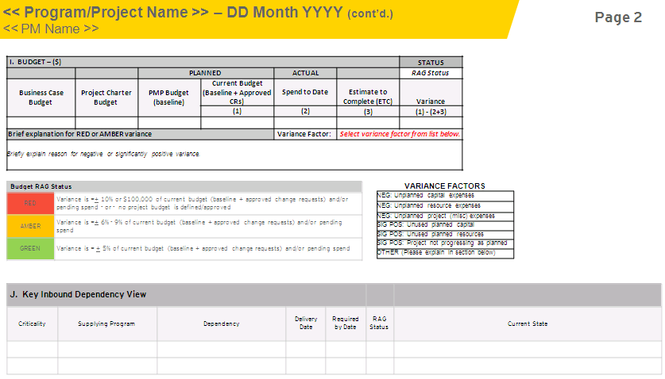
Status report guidance
Variances will be reported on the project budgets (over the life of the project) as either negative or positive.
If estimate at completion (EAC) exceeds the stated thresholds either negatively or positively, need to complete two additional fields. See #3 and #4 explanations below.
1
2
Enter RAG status based on resulting variance. See status definitions.
A pre-defined list of reasons for variance.
3
One(1) to 3 sentences explaining the reason for RED or AMBER status.
4
NOTE: Reporting of critical dependencies is only expected of Enterprise Programs. This is an optional section for all other programs/projects.
Critical: Program not able to execute if deliverable not available on time. No contingency available. Intense monitoring required. Dependency is directly impacting critical path.
Significant : Program may be able to execute if deliverable not available on time. Contingency available but at high cost and w/significant lead time.
Planned delivery date for work / milestone.
Required date for completing / delivering work / milestone.
5
8
Provide a RAG status on dependency.
Program(s) depending upon work/milestone.
6
9
11
7
10
Self-explanatory.
Description of dependency.

Slide 4
Confidence ratings
 | Rating | Description | Probability of occurrence*
1 | Estimate | Low confidence that milestone date will be met | Less than 50% | Very likely not to occur
2 | Target | Moderate confidence that milestone date will be met | Somewhere in the middle - between 51% and 79% | Good chance, but some doubt exists
3 | Committed | High confidence that milestone date will be met | 80% or higher | Very likely to occur
This needs to be a “guesstimate” from the project manager” based on how the project is tracking in the Project Schedule. No scientific measure exists at this time.

